Slide 1
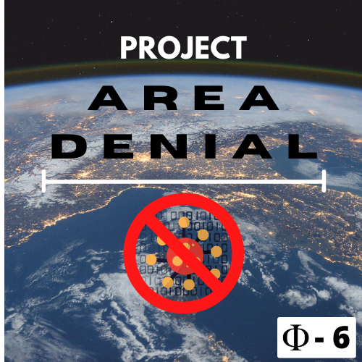
Click once to play the whole slideshow

Slide 2

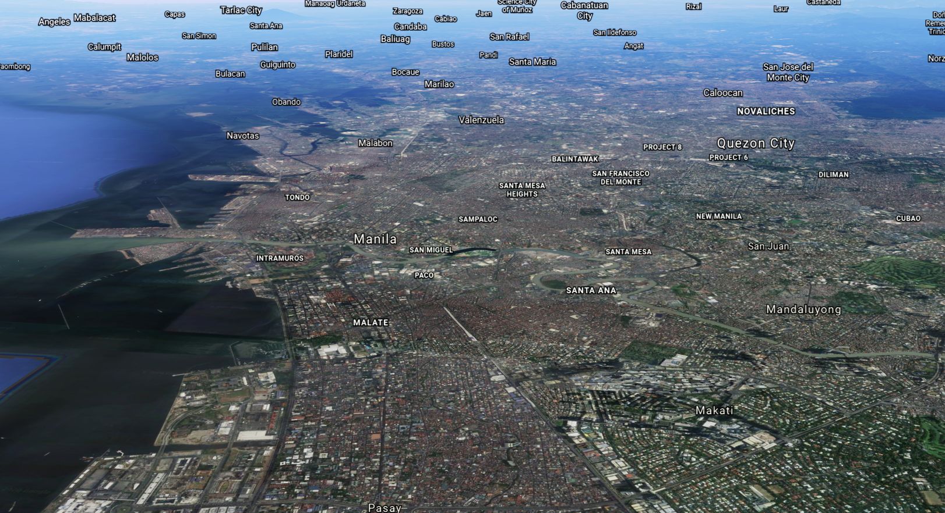
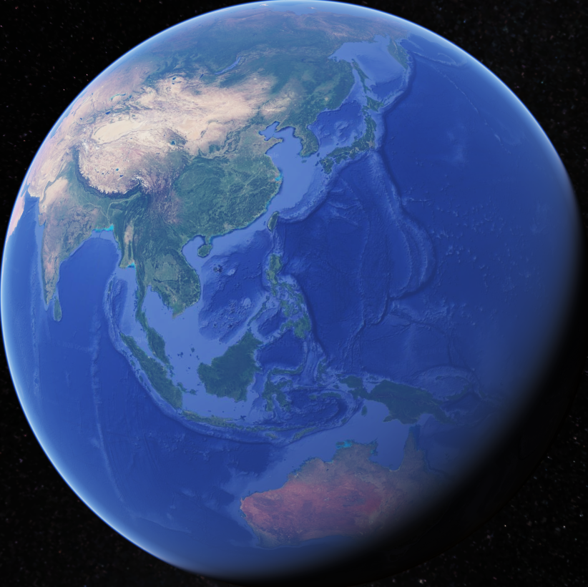
We are planning to build a website to predict how much of a COVID-19 hotspot a city is
pixelstalk.net

